Slide 1
Camphor Boats
21 Oct 2014

Slide 2
Preparation
5% Agarose gel sheets
Cut out the required diameter tablets.
Soak the tablets in camphor saturated methanol solution for more than an hour.
Rinse the tablets in DI water to precipitate camphor in the gel matrix.

Slide 3
Work Plan
Dhiraj
Sathish
Mechanism governing the motion of single camphor boat.
Fluid dynamics associated with single camphor boat.
Tuning of parameters affecting the motion of single camphor boat.
Characterization of motion of a single camphor boat.
Studying the collective dynamics of camphor boats under normal conditions.
Studying the collective dynamics of camphor boats under different physical conditions based on the input from Dhiraj.

Slide 4
Pair-potential
Short-range attractive. Attraction length depends on the surface tension of water, temperature.
Long-range repulsive. Repulsion length depends on the size of the camphor boat, pH of water, temperature, surface tension, etc.
Not radially symmetric while boats are in motion.

Slide 5
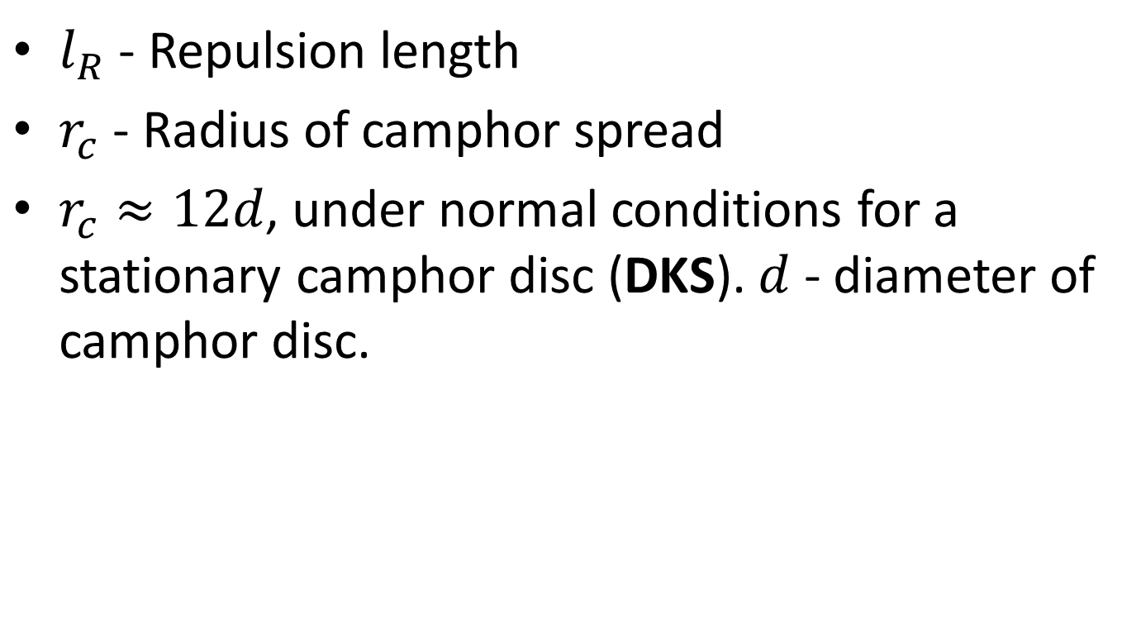

$l_{R}≡?r_{c}$
$l_{R}$ - Repulsion length
$r_{c}$ - Radius of camphor spread
$r_{c}≈12d$, under normal conditions for a stationary camphor disc (DKS). $d$ - diameter of camphor disc.

Slide 6
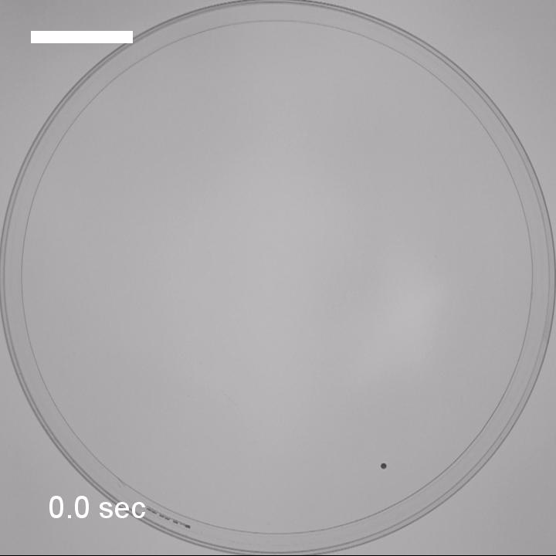
Single Camphor Boat

Slide 7
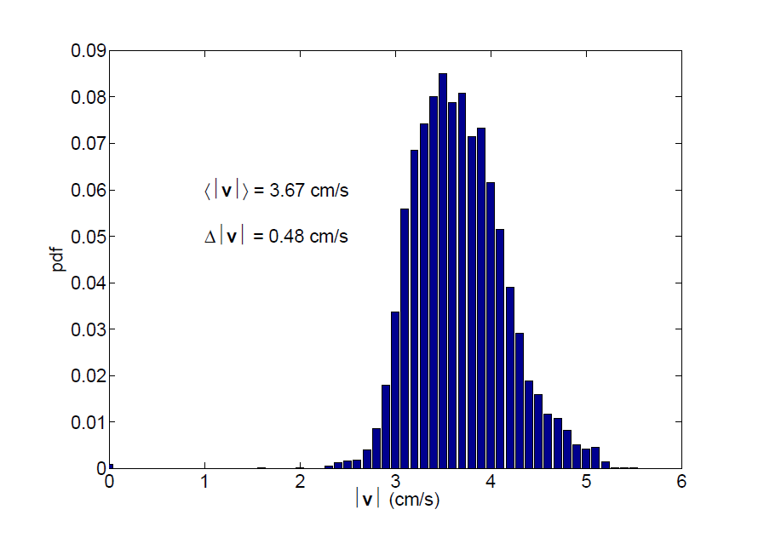
PDF (Single Camphor Boat)

Slide 8
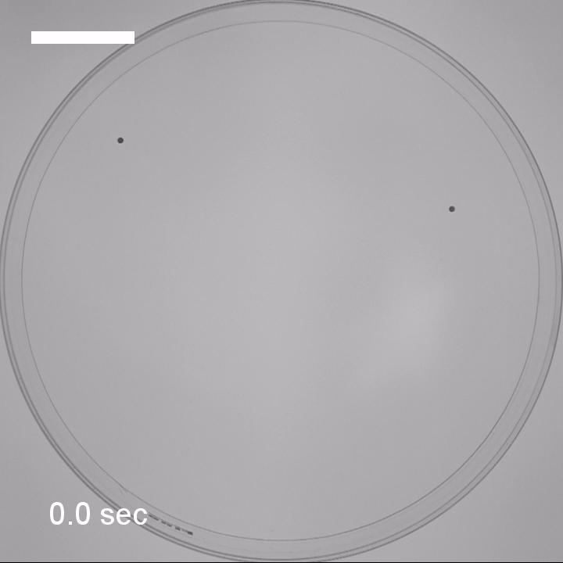
2 Camphor Boats

Slide 9
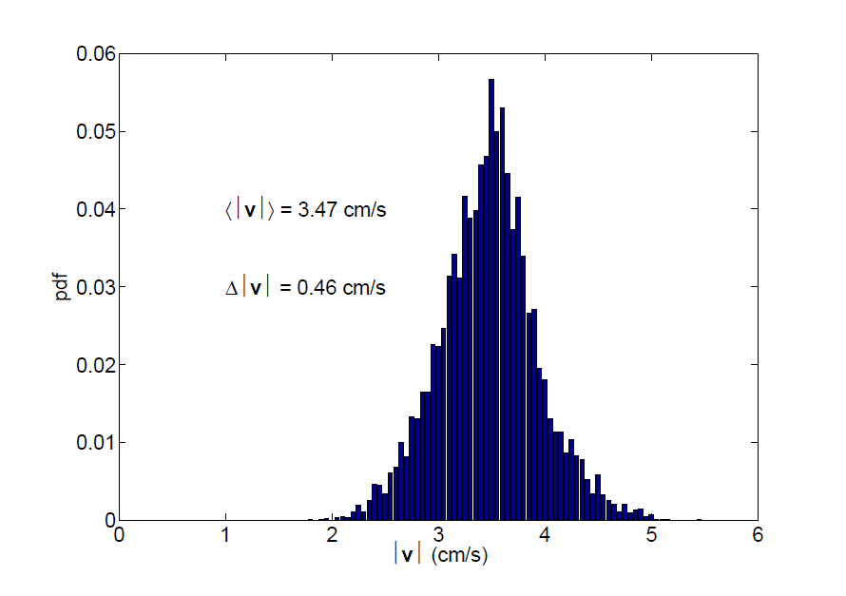
PDF (2 Camphor Boats)

Slide 10

4 Camphor Boats

Slide 11
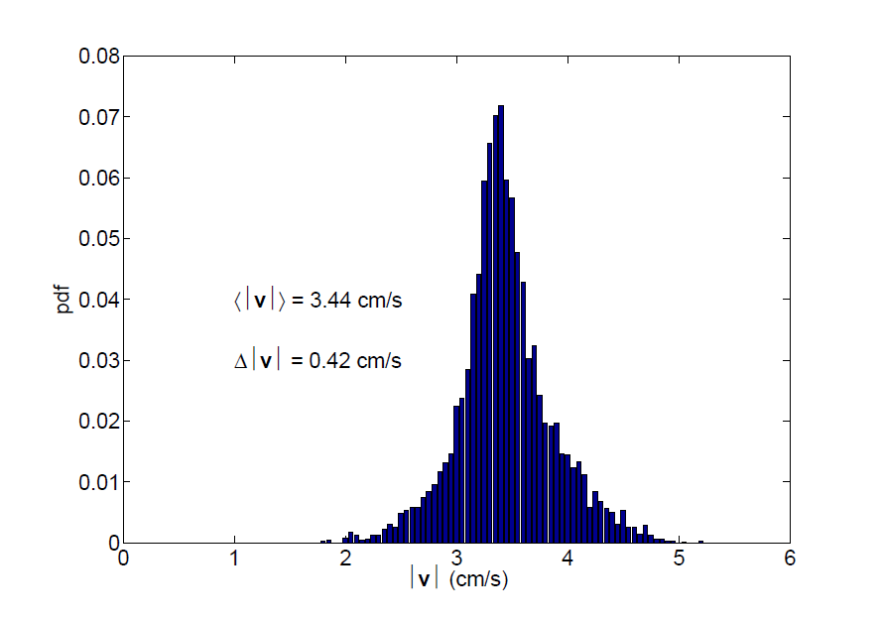
PDF (4 Camphor Boats)

Slide 12

8 Camphor Boats

Slide 13
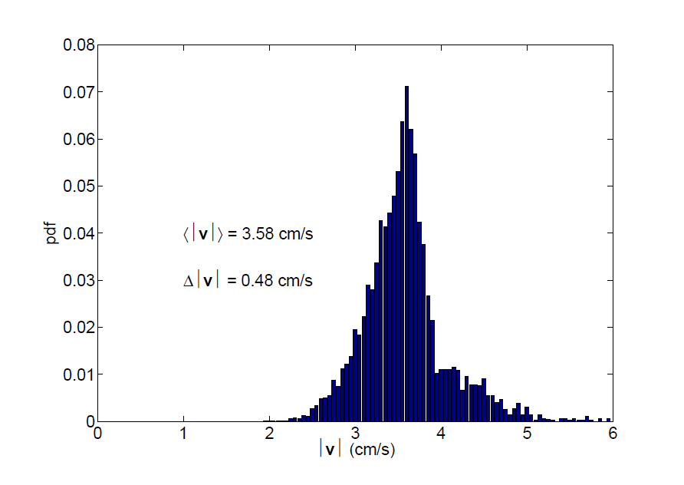
PDF (8 Camphor Boats)

Slide 14
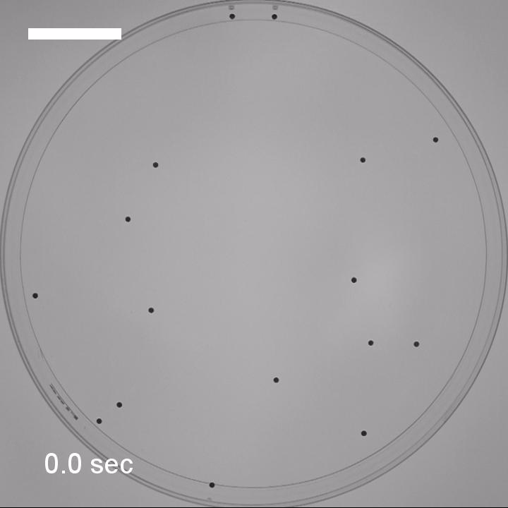
16 Camphor Boats

Slide 15
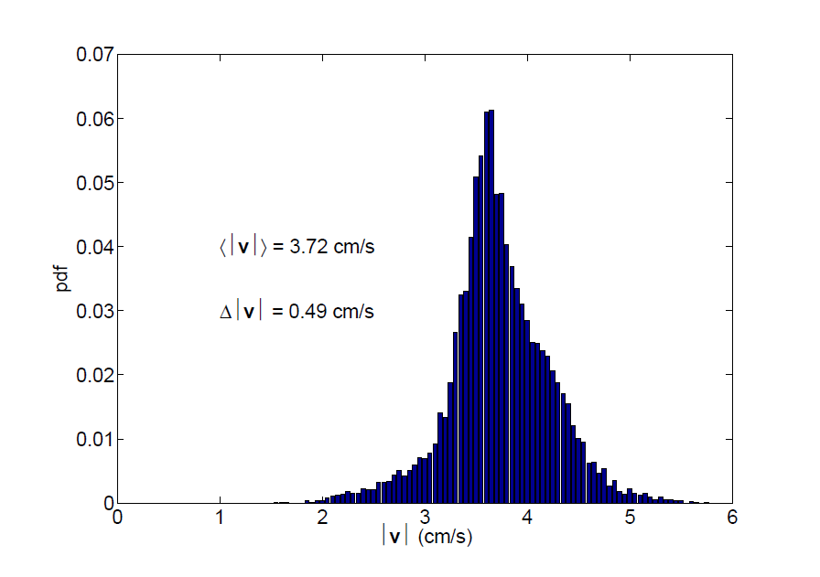
PDF (16 Camphor Boats)

Slide 16
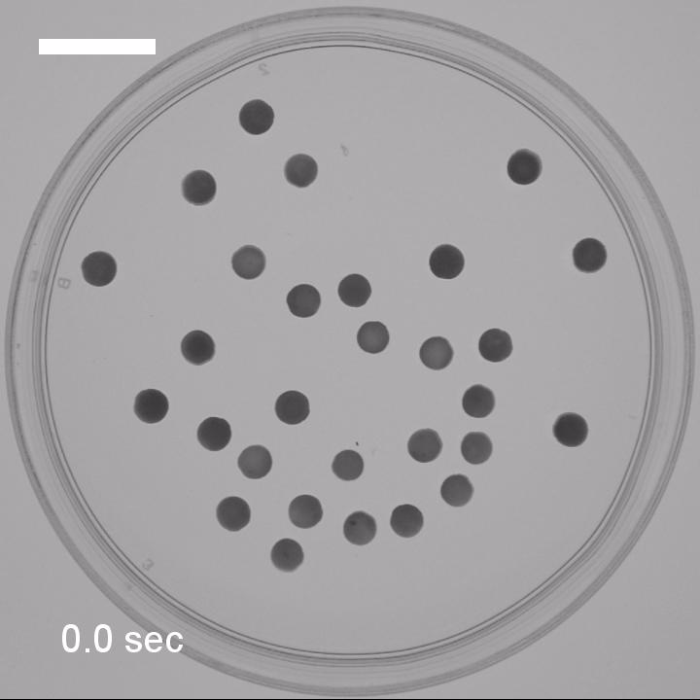
29 Camphor Boats

Slide 17
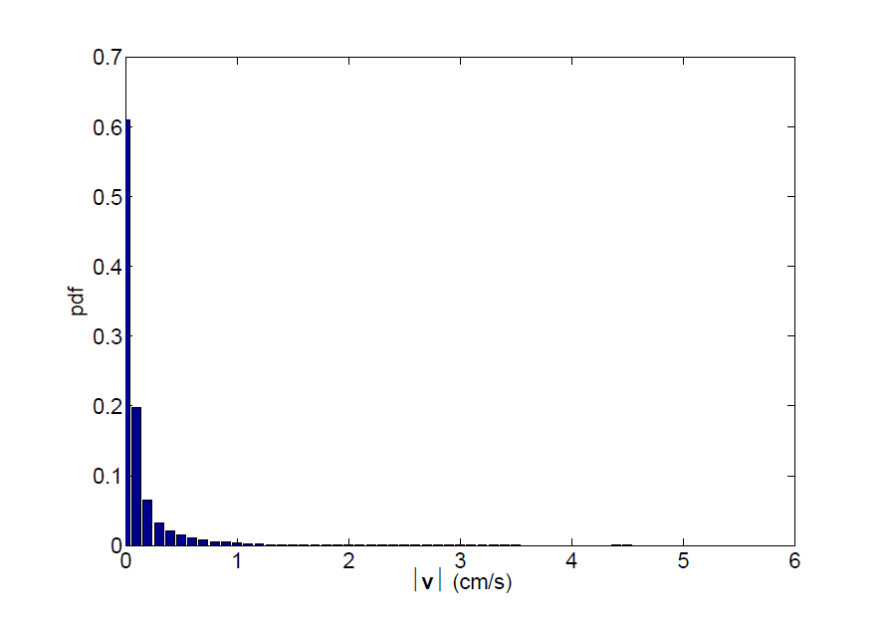
PDF (29 Camphor Boats)

